Slide 1
DDS Analytics Employee Turnover Prediction
Talent Management Insights by
Nick Blair
Notes:
<Nick>

Slide 2

Outline for today
Top factors in employee attrition
http://gcmouli.com/blog/2017/01/inference-and-insights/
Notes:
<Nick>

Slide 3
Outline for today
Top factors in employee attrition
Other interesting trends & observations
http://gcmouli.com/blog/2017/01/inference-and-insights/
Notes:
<Nick>

Slide 4
Outline for today
Top factors in employee attrition
Other interesting trends & observations
Predicting attrition
http://gcmouli.com/blog/2017/01/inference-and-insights/
Notes:
<Nick>

Slide 5
Overview of data: Set layout
870 individual employee records
Includes wide variety of numeric and categorical data
Attrition: 170 positive, 730 negative (19.5% attrition rate)
Notes:
<Jamie>
Combined data set contains the following variables:
Brewery ID
Brewery name
Brewery location (city and state)
Beer name
Beer name and ID
(each row is a separate beer; this means the same locations, brewery names, and brewery IDs appear frequently)
ABV value for each beer
IBU value for each beer
Style of each beer
Volume in ounces that the beer is served by
Colorado has 47 total breweries including two instances of Oskar Blues brewery.

Slide 6
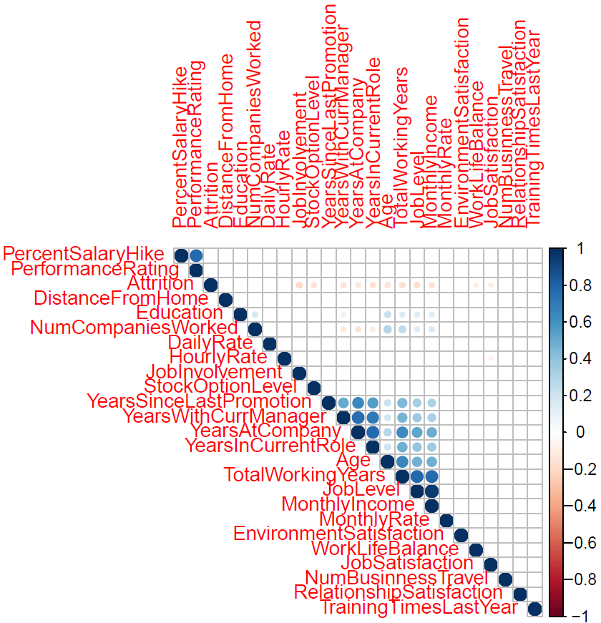
Top predicting factors for attrition
Monthly Income
Many confounding variables
Notes:
<Nick>

Slide 7
Top predicting factors for attrition
Monthly Income
Many confounding variables
Job Involvement
Notes:
<Nick>

Slide 8
Top predicting factors for attrition
Monthly Income
Many confounding variables
Job Involvement
Job Satisfaction
Notes:
<Nick>

Slide 9
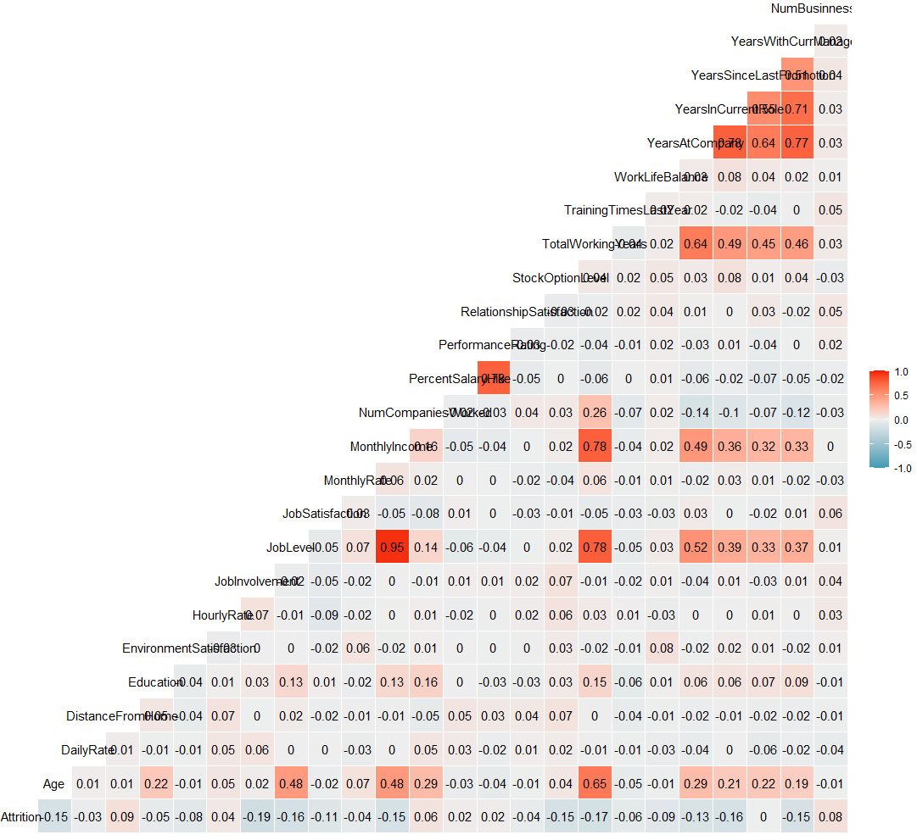

Slide 10
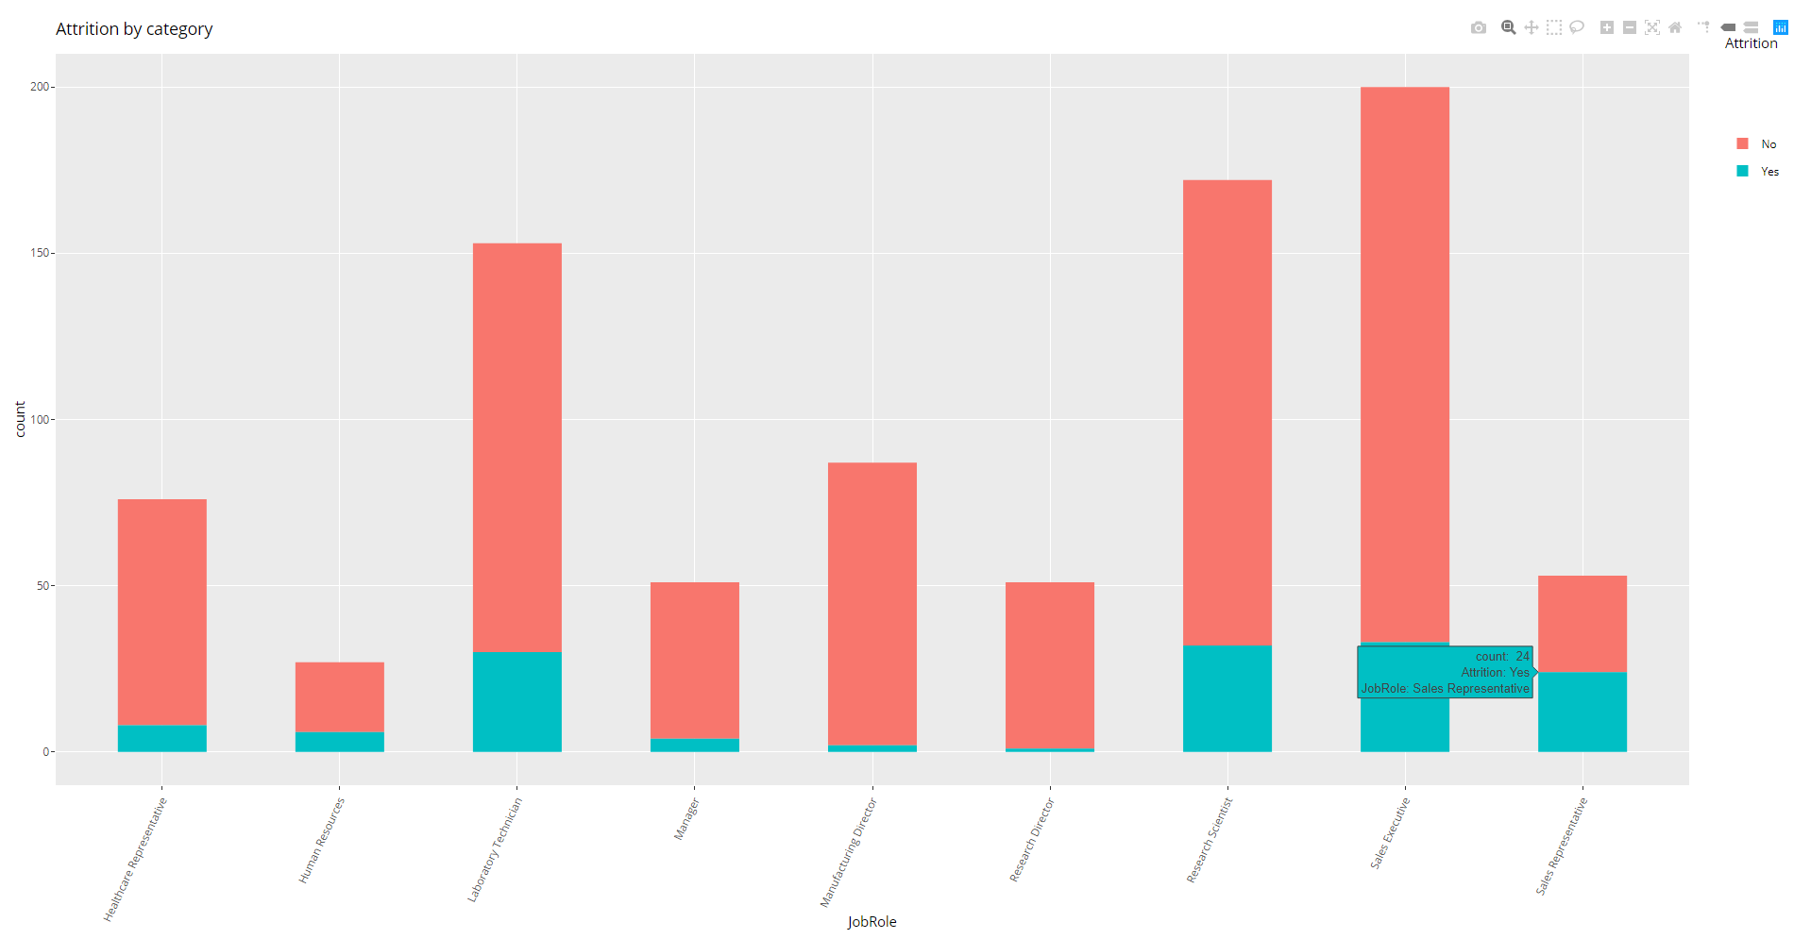
Other interesting trends: Job Role

Slide 11
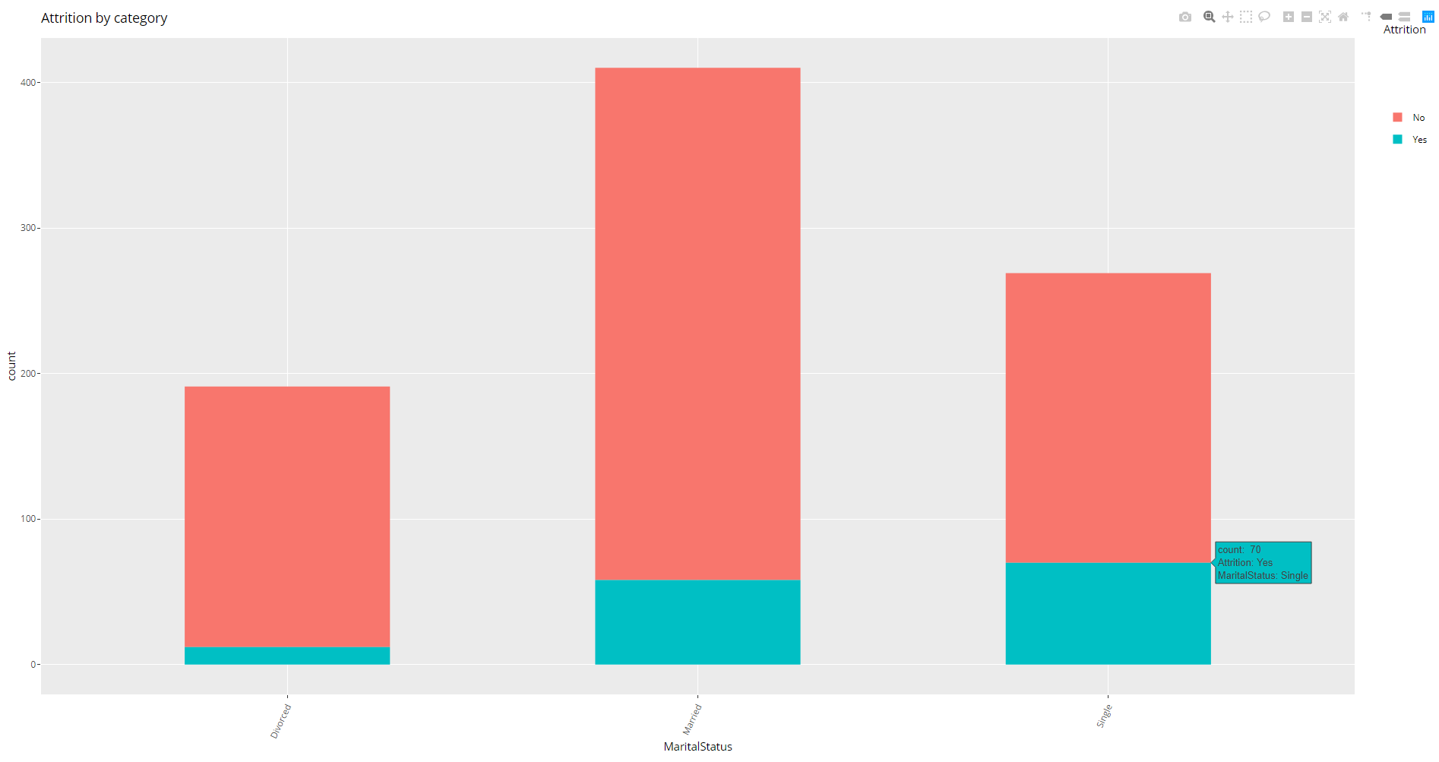
Other interesting trends: Marital Status

Slide 12
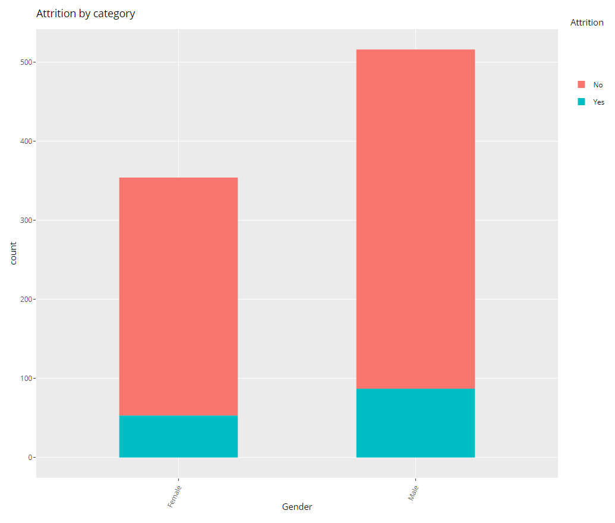
Other Interesting Trends: Gender

Slide 13
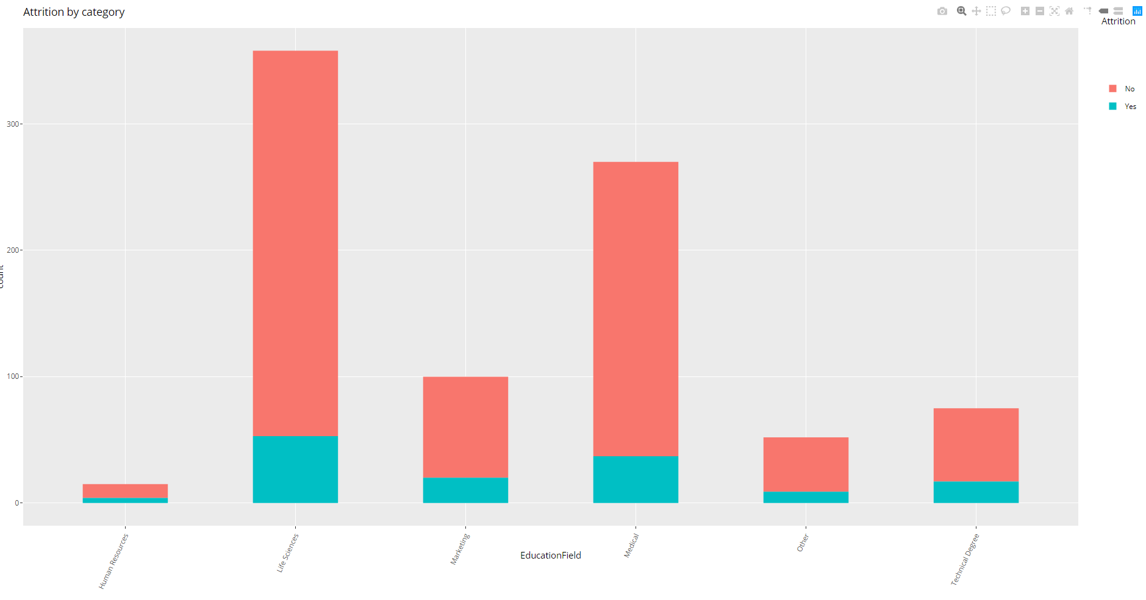
Other Interesting Trends: Education Field

Slide 14
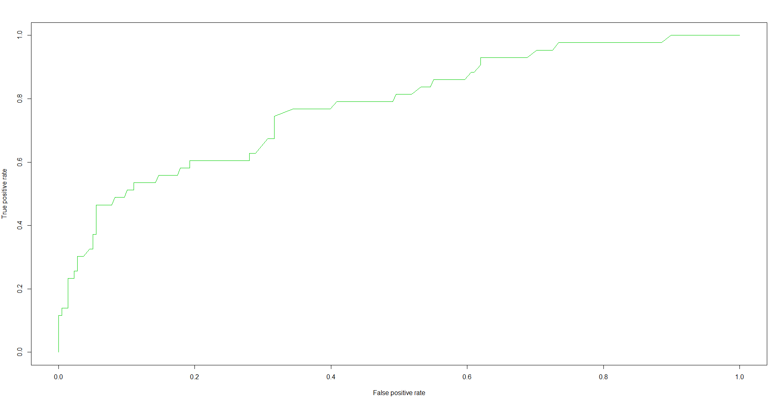
Predicting Attrition

Slide 15

Thank you for your time and considertation!
Further questions or concerns? Please contact:
Nick Blair (nicholasb@smu.edu)
DDS
Photo credit: https://www.budweisertours.com/locations/st-louis-missouri.html
Notes:
<Indy>

Slide 16
<Problem?>
<Solution code/explanation>

Slide 17
<Problem?>
<Written conclusion>

